Slide 1
SQL Programming
DDL - Defining Tables

Slide 2
Module 02: Defining Tables Page A-1: Intro
In the first semester SQL class you learned how to create basic or ‘rudimentary’ tables.
These table were comprised of simple number, character, and date columns.
This module introduces you to the full set of column types (data types) that are available in the SQL:1999 standard. We’ll discuss each data type and consider its use from an operational perspective. Once you learn these column types, you can create a database that’ll hold just about anything.
In the next module we’ll discuss constraints and other techniques that the database designer can use to enforce data policies.

Slide 3
Module 02: Defining Tables Page B-1: Data Types
Data types can be classified into these main categories:
Type Module Section
Binary (B)
Boolean (C)
Character / String (D)
Numeric (E)
Temporal / DateTime (F)
And we’ll examine each of them in the remaining sections of this module.

Slide 4
Module 02: Defining Tables Page B-2: Binary
In the binary data type category, the standard provides these three options:
BIT (n)
BIT VARYING (n)
Binary Large Object (n)
The BIT and BIT VARYING options allow the programmer to define a column as being a collection of bits of size n. The BIT data type specifies a fixed length field, the BIT VARYING data type allows for a variable length size field.
Generally this data type is used for ‘special’ applications, and the data is usually manipulated by an external program (user procedure) rather than directly with SQL.

Slide 5
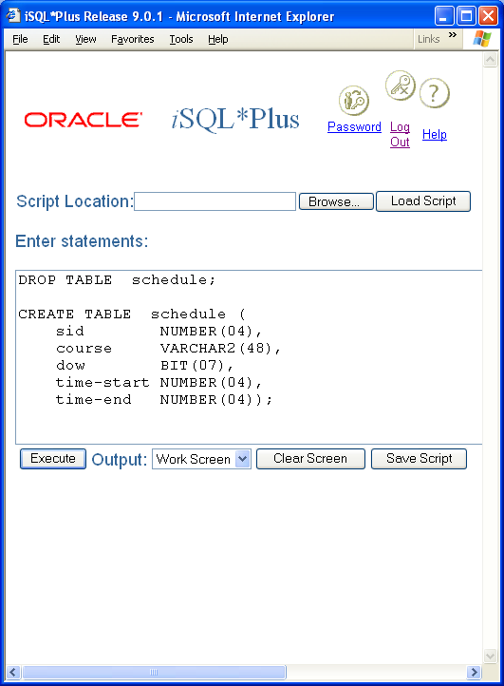
Module 02: Defining Tables Page B-3: Binary DOW Grid
Let’s consider a scheduling application, more specifically, a class scheduling application that would manage the information about the classes that are offered in any given semester.
Classes can be offered in almost any combination of days and times, and we often see patterns in a class schedule that look something like these:
ANTHR-101 MWF 0800-0850
BIOL-100 M 1900-2140
LING-501 TTh 0930-1045
MATH-150 MTWThF 1000-1050
The column that represents the days of the week carries some ambiguous information. Does T stand for Tuesday, or is it part of the Th indicator for Thursday? Does S stand for Saturday, or is it part of the indicator for Su for Sunday? These abbreviations are apparent to the human that reads the schedule, but for the computer, these values must be parsed/evaluated for their meaning. One other drawback with this representation is that it’s difficult to properly sort the class listing by time and day of week.

Slide 6
Module 02: Defining Tables Page B-4: Binary DOW Grid
One way to remedy these problems would be to create a 7-character grid, with a slot for each day of the week. The first slot could be assigned to Mondays, the 2nd to Tuesdays, the 3rd to Wednesdays, …
And in this grid we could use bit values (binary digits) to indicate whether or not the class meets on the corresponding day.
Here’s how our previous set of data might be represented:
ANTHR-101 MWF 0800-0850
ANTHR-101 1010100 0800-0850
BIOL-100 M 1900-2140
BIOL-100 1000000 1900-2140
LING-501 TTh 0930-1045
LING-501 0101000 0930-1045
MATH-150 MTWThF 1000-1050
MATH-150 1111100 1000-1050

Slide 7
Module 02: Defining Tables Page B-5: Binary DOW Grid
This gives us a structure that we can model in the database, ie. A BIT data type (of size 7).
But how do we update these values? Say a class offering changes from a Mon Wed pattern to Tue Thurs? How do we update the specific bits inside the BIT column?
Unfortunately, SQL falls short. At best, it can replace the entire bit string with a new value, but it doesn’t have the ability to update a single column in that grid.
Hence these data types are often passed off to some computer program (process, or stored procedure) that was written specifically to deal with the information that is encoded in them.
Oh, and one other thing. Although the standard defines these two data types, neither Oracle nor Access support them ☺

Slide 8
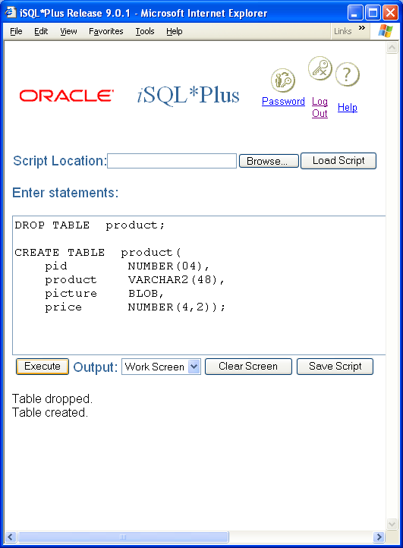
Module 02: Defining Tables Page B-6: BLOB
In the same fashion that BIT and BIT VARYING data types are used to hold a structure that will be manipulated by a special program, BLOBs also rely on some special procedure to retrieve and manipulate their values.
BLOB is an acronym for Binary Large Object, and BLOBs are used to hold large collections of bits.
Perhaps the most common use for BLOBs is to store graphic images in their ‘native’ GIF or JPEG format within the database. You often see these applications in e-commerce sites that display an image of the catalog item. That image is most often stored in a database in its native GIF or JPEG format.
And once again, although the values are stored in the database, there is usually some special program that is used to load the values into the table, and then to retrieve or update the values.

Slide 9
Module 02: Defining Tables Page B-7: BLOB
Note that the programmer does not need to specify a size for columns that are defined as BLOB data types in the Oracle database.
Read your database vendor’s literature to determine the limitations on these columns (For Oracle 9.2, BLOBs are limited to 4 gigabytes)

Slide 10
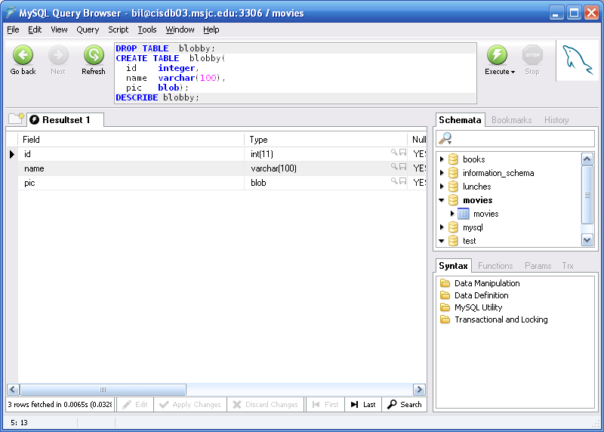
Module 02: Defining Tables Page B-8: BLOB
MySQL provides the programmer with four BLOB types:
TYPE Max Size
TINYBLOB 256
BLOB 655536
MEDIUMBLOB ~ 16 million
LONGBLOB ~ 4 billion
Note: None of these datatypes takes a length, or size value, in their definition. Instead, the size,
or length of these columns is
limited by the max size for the
datatype.
We’ll have more to say about
BLOBs in the next section.

Slide 11
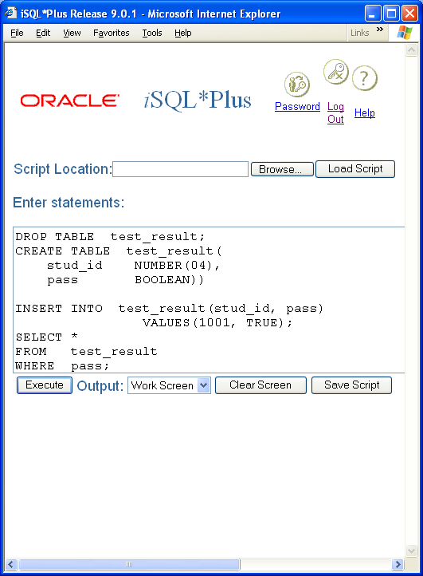
Module 02: Defining Tables Page C-1: Boolean
A Boolean data type is used to store truth values: TRUE, FALSE, and UNKNOWN.
These data types are best used then, when the programmer needs to store the value of a predicate expression.
For example, a column in a table could be used to store one of two values: Pass or Fail. The WHERE clause predicate that would be used to locate all rows with a ‘Pass’ value would look something like this:
WHERE test = ‘Pass’
Alternatively the column could be designed to store a Boolean value, and rather than storing Pass and Fail, we would store TRUE if the student passed the exam, and FALSE otherwise.
The WHERE clause predicate that would retrieve the same set of rows as the previous example could be coded as either of the following:
WHERE pass
WHERE pass IS TRUE

Slide 12
Module 02: Defining Tables Page C-2: Boolean
Oracle does not support the Boolean data type as a native type.
That is, there isn’t a data type in the database that you can use to define and store these values.
Strangely enough though, the Oracle programming language PL/SQL, does allow the programmer to define variables as Boolean data types in those programming applications. You just can’t store the values back into the database?
MySQL also does not support a BOOLEAN datatype.

Slide 13
Module 02: Defining Tables Page D-1: Character
Character data types are represented in the standard with these options:
CHARACTER (n)
CHARACTER VARYING (n)
CHARACTER LARGE OBJECT (n)
CLOB(n)
And
NATIONAL CHARACTER (n)
NATIONAL CHARACTER VARYING (n)
NATIONAL CHARACTER LARGE OBJECT(n)
NCLOB (n)

Slide 14
Module 02: Defining Tables Page D-2: Character
CHARACTER data types are used to represent fixed length character strings, CHARACTER VARYING is used to represent variable length character strings.
Similarly, NATIONAL CHARACTER data types are used to represent fixed length character strings, and NATIONAL CHARACTER VARYING is used to represent variable length character strings. There’s more to say about Nationals, but I need to lay down some theory first, and I’ll do that in a sec’.
CLOBs are used to store large collections of characters, as are NCLOBs. One might use a CLOB to store the text of a short story, or maybe even a novel.

Slide 15
Module 02: Defining Tables Page D-3: Character Sets
CHARACTER and NATIONAL CHARACTER are inextricably tied to the way character sets are used and represented on the computer.
When you were in grade school (perhaps pre-school for some of you, and high school for others ☺) you learned the alphabet. For our discussion, we’ll presume that that alphabet was the American English alphabet. The first letter is ‘A’ (pronounced ey), and the last letter is ‘Z’ (pronounced zee).
Unlike the British English alphabet whose first letter is ‘A’ (pronounced ey), and whose last letter is ‘Z’ (pronounced zed), but I digress.
When the character A is written or printed on a page we call that mark or symbol a ‘glyph’. And the A-glyph looks like: A

Slide 16
Module 02: Defining Tables Page D-4: Character Sets
Back to grade school.
When you learned the alphabet, you learned to read and write the glyphs for the letters (characters), and you also learned the ordering scheme for the alphabet: ABCDEFGHIJKLMNOPQRSTUVWXYZ
The ordering scheme is known as the collation scheme (or collating sequence) and we use it every time we want to arrange or alphabetize some list.
Now these features are generally implemented in the character set of the computer. Most computers use ASCII.
What does ASCII stand for?

Slide 17
Module 02: Defining Tables Page D-5: Character Sets
Back to grade school.
When you learned the alphabet, you learned to read and write the glyphs for the letters (characters), and you also learned the ordering scheme for the alphabet: ABCDEFGHIJKLMNOPQRSTUVWXYZ
The ordering scheme is known as the collation scheme (or collating sequence) and we use it every time we want to arrange or alphabetize some list.
Now these features are generally implemented in the character set of the computer. Most computers use ASCII.
What does ASCII stand for?
ASCII is an acronym for American Standard Code for Information Interchange.

Slide 18
Module 02: Defining Tables Page D-6: Character Sets
The magic word here is: American.
ASCII works really well for the American English Alphabet. It doesn’t work so well for other languages.
The ASCII character set uses the 8-bits in a byte to represent individual characters. And the collation scheme is defined as the (sorted) arrangement of those bit combinations. And each bit pattern is associated with a character (glyph).
How many bits are there in a byte?

Slide 19
Module 02: Defining Tables Page D-7: Character Sets
The magic word here is: American.
ASCII works really well for the American English Alphabet. It doesn’t work so well for other languages.
The ASCII character set uses the 8-bits in a byte to represent individual characters. And the collation scheme is defined as the (sorted) arrangement of those bit combinations. And each bit pattern is associated with a character (glyph).
How many bits are there in a byte?
Most computers use 8 bits per byte.
How many bit patterns can be generated with 8 bits?

Slide 20
Module 02: Defining Tables Page D-8: Character Sets
The magic word here is: American.
ASCII works really well for the American English Alphabet. It doesn’t work so well for other languages.
The ASCII character set uses the 8-bits in a byte to represent individual characters. And the collation scheme is defined as the (sorted) arrangement of those bit combinations. And each bit pattern is associated with a character (glyph).
How many bits are there in a byte?
Most computers use 8 bits per byte.
How many bit patterns can be generated with 8 bits?
256 patterns, or combinations, are possible with 8 bits.

Slide 21
Module 02: Defining Tables Page D-9: Character Sets
Each 8-bit pattern is laid out in bits, and has a binary value. That binary value also has a decimal equivalent.
Bit pattern Decimal value
00000000 0
00000001 1
00000010 2
00000011 3
00000100 4
00000101 5
…
01000001 65
01000010 66
01000011 67
…
11000001 97
11000010 98
11000011 99
…
11111111 255

Slide 22
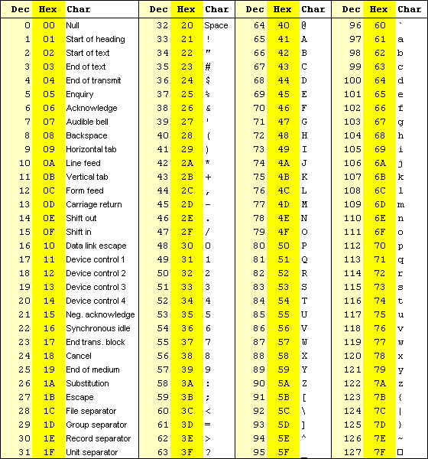
Module 02: Defining Tables Page D-10: Character Sets
In the ASCII character set, the bit pattern whose decimal value is 65 represents the letter/character A.
Here’s the “bottom-half” of ASCII table. Notice how everything works well for American English?
But what about Spanish? Where are the letters of the Spanish alphabet in the ASCII collation scheme? They’re in the “other” half…
Ñ é
For example, these two letter are ‘tossed’ in at the end of the American English characters, and since they’re at the end, when you sort a list of Spanish words (perhaps Spanish names), these characters do not appear as they should for a Spanish collation.

Slide 23
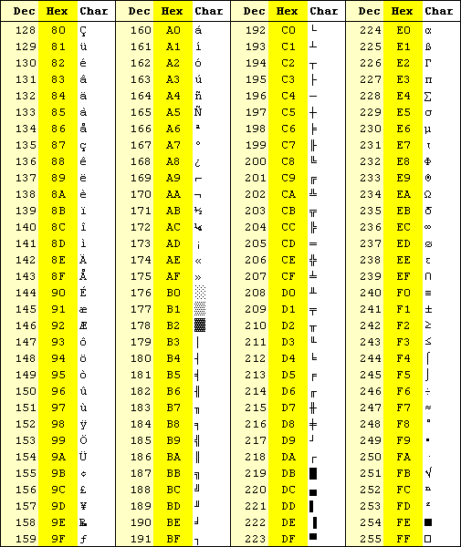
Module 02: Defining Tables Page D-11: ASCII Table
From: http://www.cdrummond.qc.ca/cegep/informat/Professeurs/Alain/files/ascii.htm

Slide 24
Module 02: Defining Tables Page D-12: Unicode
Unicode, short for Universal Character Set, was developed as an attempt to address this problem.
The short story is that the Unicode character set uses two bytes to represent any character. These 2 bytes provide 16 bits, or 65,536 (2¹⁶) possible patterns to represent 65,536 unique characters.
This pretty much covers every known alphabet, (although it still falls short of supporting all possible glyphs in languages such as Mandarin and Korean).
Many database vendors provide support for Unicode.

Slide 25
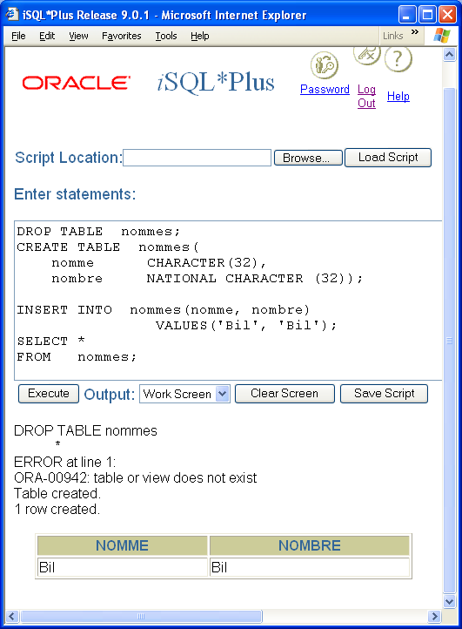
Module 02: Defining Tables Page D-13: Character Sets
Which leads us, finally, to a discussion of NATIONAL CHARACTER.
National character is an attempt to accommodate internationalization efforts in relational database systems. As the scope of applications has grown beyond political and language boundaries, the data maintained in databases has had to accommodate these developments.
The national character set extends the available cast of characters and is usually defined at the time the database is created.
Popular character sets that might be specified as the national character set include:
ASCII
ARABIC7
LATIN1
KANJI
…
Unicode

Slide 26
Module 02: Defining Tables Page D-14: Character Sets
Since the national character set is defined at the time the database is created (on Oracle systems), this means that the programmer can only invoke or use a character set that has been previously defined. This is not a feature that can be called into use ‘on the fly’.
Now, according to the standard, the programmer can specify which character set to use for any character data type, as shown in the example (unfortunately this feature is not supported by Oracle).
This does not challenge the comment made earlier in regard to the character set needing to have been previously defined. The character set must be named and defined to the implementation. If it has been named and defined, it can be used.
I think of the National Character as a simple way to specify a second default.

Slide 27
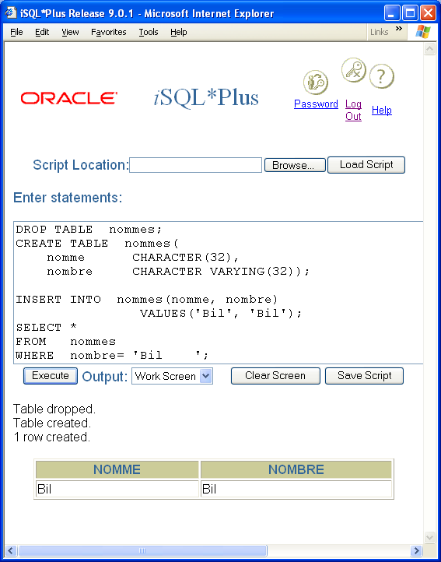
Module 02: Defining Tables Page D-15: Character Sets
CHARACTER VARYING trims all trailing blanks from the field.
CHARACTER pads a column with blanks so as to insure that there are as many characters in the column as it’s defined to contain.
Note the different effect of these two where clauses.
This example compares the column nombre, character varying, with the value ‘Bil ’, a padded literal.
The test succeeds.

Slide 28
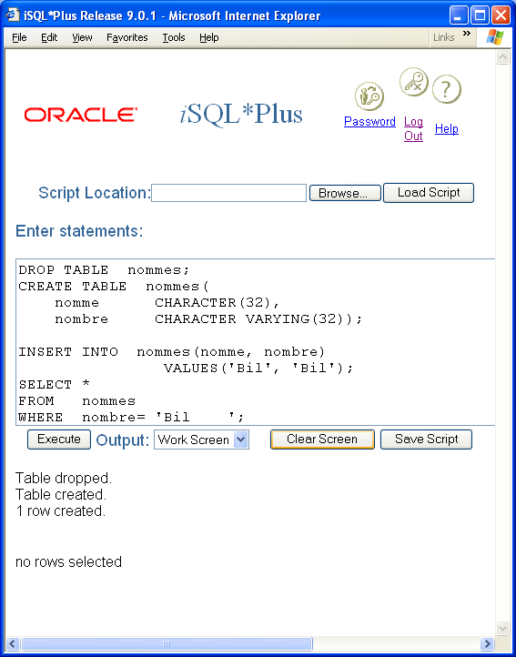
Module 02: Defining Tables Page D-16: Character Sets
This example compares the value ‘Bil ’ with the value ‘Bil’ in a fixed length character column.
The test fails.

Slide 29
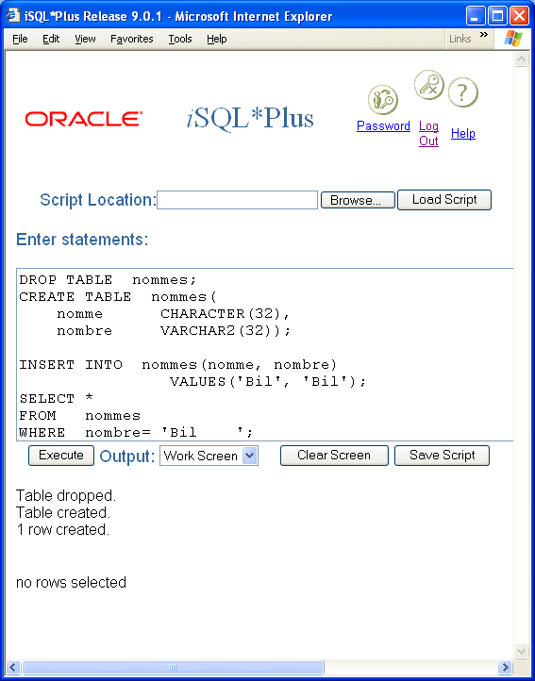
Module 02: Defining Tables Page D-17: Character Sets
Oracle also uses the data type VARCHAR and VARCHAR2 to signify a CHARACTER VARYING column.

Slide 30
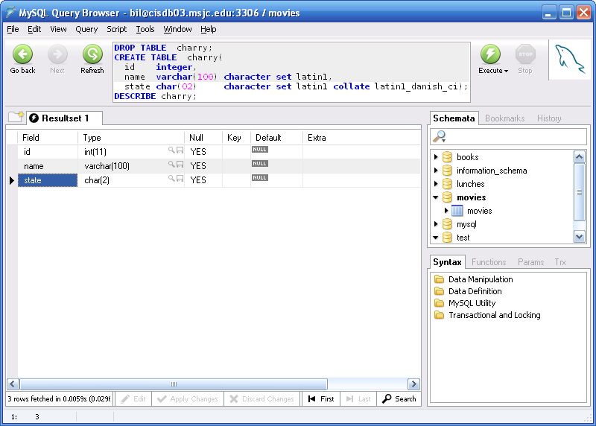
Module 02: Defining Tables Page D-18: Character Sets
MySQL provides CHAR and VARCHAR datatypes, AND it also permits the developer to define the character set and the collation sequence for each of these datatypes.

Slide 31
Module 02: Defining Tables Page D-19: Character Sets
Character datatypes in MySQL are classified as being either binary, or non-binary strings.
You can think of binary strings as the most ‘basic’ of strings. Their internal representation carries nothing more than the numeric value of the character.
Non-binary strings are a bit more “full-featured” than binary strings. A non-binary string is associated with a character set and a collation.
Non-binary string comparisons are based on the collation of the character set, binary string comparisons are based only on the numeric value of the characters in the string.

Slide 32
Module 02: Defining Tables Page D-20: Character Sets
The following table highlights the different binary and non-binary datatypes that are available in MySQL.
For the SQL programming classes it’s important that you recognize these data types, and appreciate that the non-binary datatypes are generally used for text, whereas the binary datatypes are more often used for ‘raw data’ (eg. images, compressed data, …).
In regard to DDL - each non-binary column in a table belongs to a character set and has a collation. If you do not specify these characteristics when you create the column, they default to the values that were defined for the table. And, unless they are explicitly defined, table characteristics default to the settings for the database.
Non-binary | binary | Fix / Var | Size | Max size in characters
CHAR | BINARY | F | 1 | 2⁸ – 1
VARCHAR | VARBINARY | V | 2 | 2¹⁶ – 1
TINYTEXT | TINYBLOB | V | 1 | 2⁸ – 1
TEXT | BLOB | V | 2 | 2¹⁶ – 1
MEDIUMTEXT | MEDIUMBLOB | V | 3 | 2²⁴ – 1
LONGTEXT | LONGBLOB | V | 4 | 2³² - 1

Slide 33
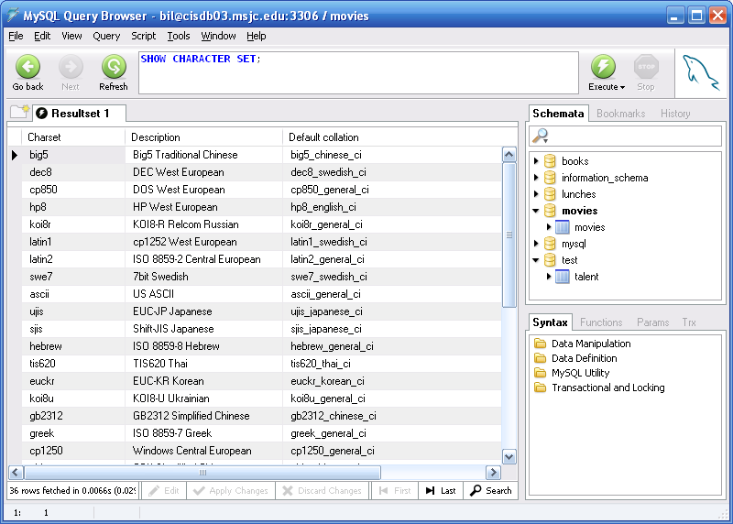
Module 02: Defining Tables Page D-21: Character Sets
The SHOW CHARACTER SET commands, displays all available character sets in the database.

Slide 34
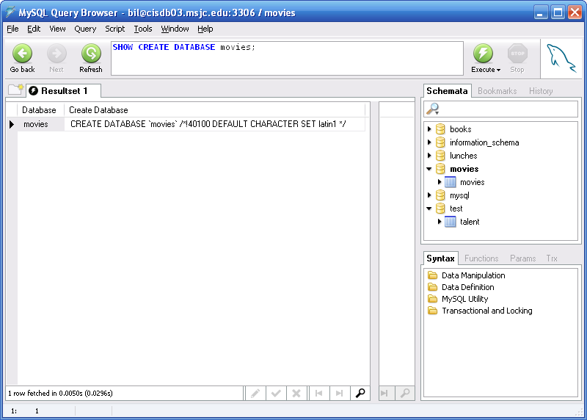
Module 02: Defining Tables Page D-22: Character Sets
To find out what the default character set is for the database, type in the SHOW CREATE DATABASE command. This will show you what MySQL ‘recalls’ about the database creation.

Slide 35
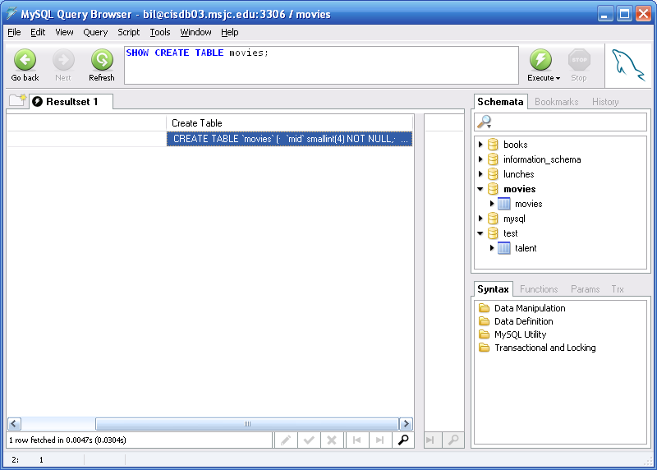
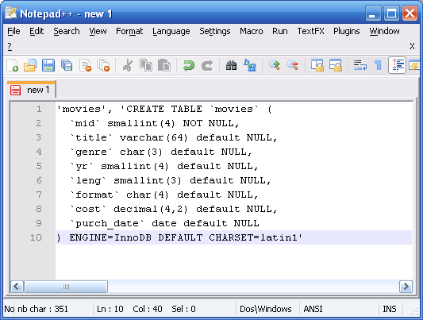
Module 02: Defining Tables Page D-23: Character Sets
To find out what the default character set is for any table, type in the SHOW CREATE TABLE command. This will show you what MySQL ‘recalls’ about that table’s creation.
I had to copy the info
from MySQL into an
editor just so we could
more easily see the
results.

Slide 36
Module 02: Defining Tables Page E-1: Numeric
The SQL:1999 standard provides for these numeric data types:
Integer
Smallint
Numeric
Decimal
Float
Real
Double precision
The first grouping of options is known collectively as exact numerics, the last three are approximate numerics.
When considering which data type to use to represent a value, check the vendor's documentation. Many (most) of the numeric data types are implementation defined (ie. vendor-specific).

Slide 37
Module 02: Defining Tables Page E-2: Exact Numerics
An exact numeric data type can represent (appropriate) numeric values exactly, without loss of precision.
Whole numbers (numbers without fractional parts) can be represented exactly.
SMALLINT
INTEGER

Slide 38
Module 02: Defining Tables Page E-3: Exact Numerics
MySQL provides these five (5) INTEGER datatypes.
Each datatype can be designated as a signed or unsigned value. Signed datatypes ‘spend’ a bit to show the sign (ie. to flag negative values), unsigned datatypes use all the bits to represent the value (positive values only).
Data type | Size in bytes | Signed Value Range | Unsigned Value Range
TINYINT | 1 | -2^{n-1} → 2^{n-1} -1 | 0 → 2^{n} -1 (255)
SMALLINT | 2 | -32768 - 32767 | (65,535)
MEDIUMINT | 3 | -8Mb – 8Mb | (16,777,215)
INT | 4 | -2B – 2B | (4,294,967,295)
BIGINT | 8 | 9.2E18 | 1.8 E19

Slide 39
Module 02: Defining Tables Page E-3: Approximate Numerics
Approximate numerics represent numeric values approximately and may account for some loss of precision.
These data types fall into this category:
REAL
FLOAT
DOUBLE PRECISION

Slide 40
Module 02: Defining Tables Page F-1: Temporal
Temporal data types are used to represent date and time values.
The temporal data types that are provided in the SQL:1999 standard include the following:
Date
Time
Time with timezone
Timestamp
Timestamp with timezone
Interval

Slide 41
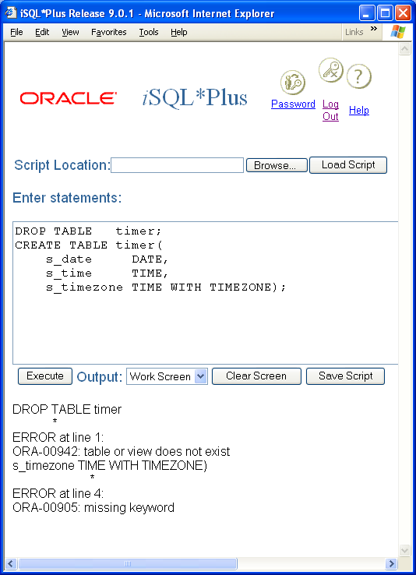
Module 02: Defining Tables Page F-2: Temporal
This is how one might define DATE, TIME, and TIME WITH TIMEZONE columns.
And as you can see, Oracle does not support the TIME data type directly. Instead it uses its own internal format (fixed-length 7 byte field) to store datetime values.

Slide 42
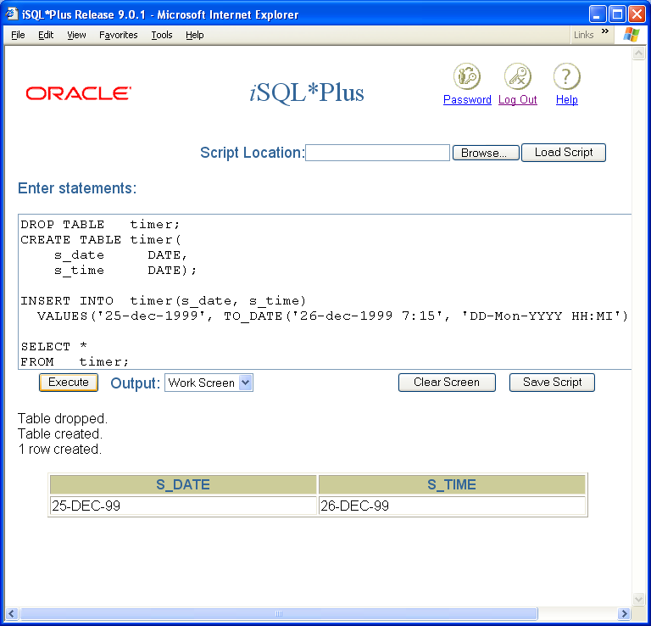
Module 02: Defining Tables Page F-3: Temporal
In Oracle, since the time values are ‘bundled’ in the date field, the DATE data type is used for these values.
The time component can only be retrieved/accessed by casting the date value to a character value with the TO_CHAR function.
The time value is not displayed for the s_time column because it was not cast to a character value, and was displayed in the default date format (dd-mon-yy).
DATE values are stored internally in a 7-byte format that supports a range of values from

Slide 43
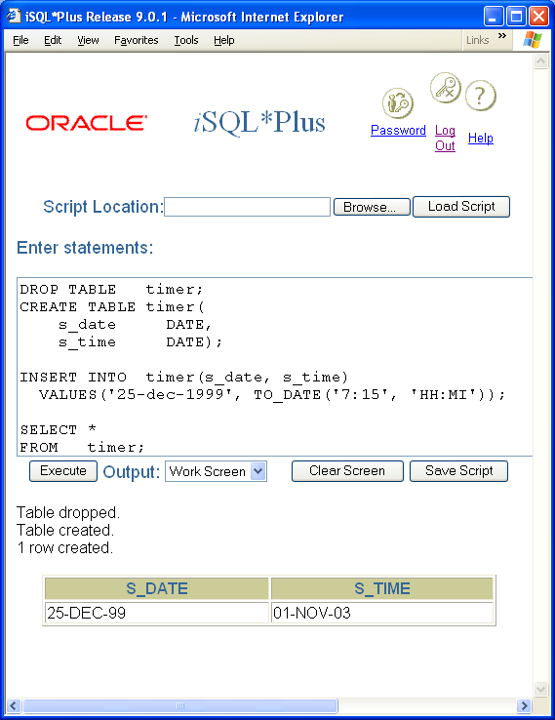
Module 02: Defining Tables Page F-4: Temporal
Note also that in Oracle, the time value cannot stand alone. If no date value is specified, the CURRENT_DATE is presumed.

Slide 44
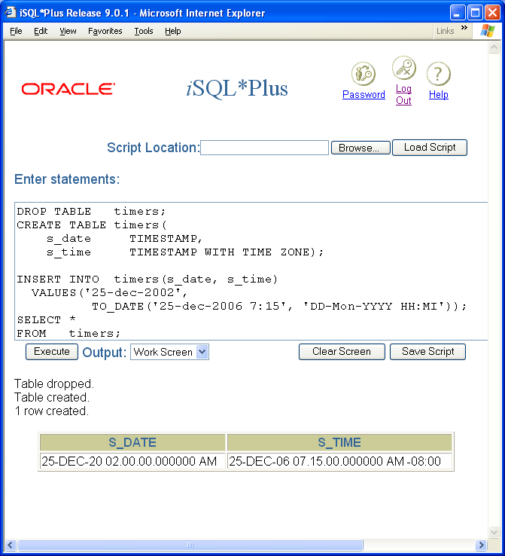
Module 02: Defining Tables Page F-5: Temporal
The TIMESTAMP data type includes a date and a time value.
The TIMESTAMP WITH TIMEZONE (TIME ZONE in Oracle) also includes a date and time value, but also includes an offset from Greenwich Meridian time.

Slide 45
Module 02: Defining Tables Page F-6: Temporal
MySQL uses these five datatypes to represent temporal values.
TIME is most often used to keep track of elapsed time, or values associated with a ‘countdown’.
TIMESTAMP stores the timestamp value internally as the number of seconds elapsed since 1970.
Datatype | Format | Size in bytes | Range
DATE | YYYY-MM-DD | 3 | 1000-01-01 thru 9999-12-31
TIME | hh:mm:ss | 3 | -838:59:59 thru 839:59:59
YEAR | YYYY | 1
 | YEAR(2) |  | 1970 Thru 2069
 | YEAR(4) |  | 1901 Thru 2155
DATETIME | YY-MM-DD hh:mm:ss | 8 | 1000-01-01 00:00:00 thru 9999-12-31 23:59:59
TIMESTAMP | YY-MM-DD hh:mm:ss | 4 | 1970-01-01 thru 2037 midyear sometime ☺

Slide 46
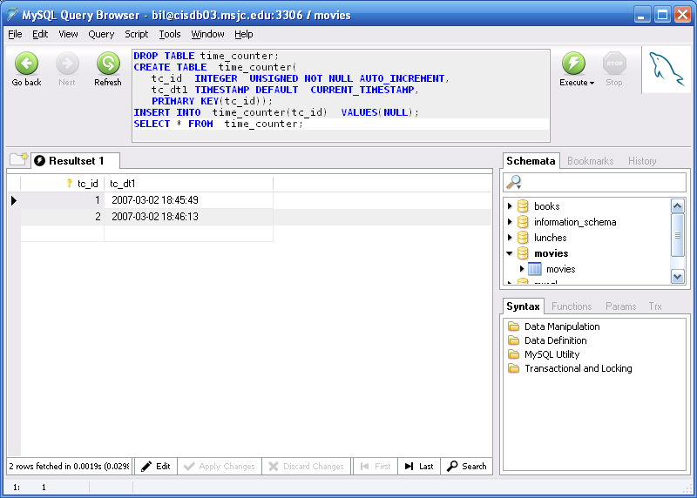
Module 02: Defining Tables Page F-7: Temporal
The TIMESTAMP column is declared with one of two optional phrases:
DEFAULT CURRENT_TIMESTAMP
ON UPDATE CURRENT_TIMESTAMP
Usually, only one timestamp column per table is declared with one of these features. But with some ‘craftiness’ the programmer can set up two columns.
The timestamp value is automatically assigned to the record when the row is first inserted. In this case, a NULL value should be assigned tot eh timestamp column.

Slide 47
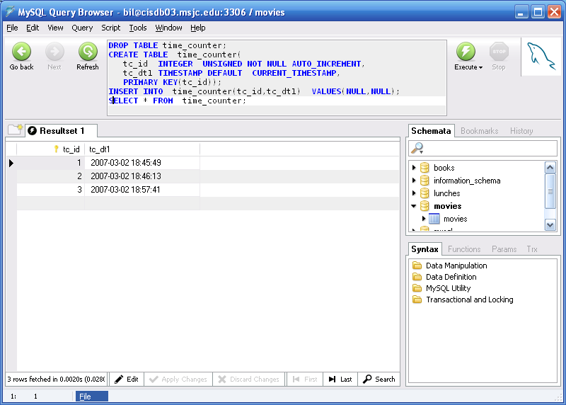
Module 02: Defining Tables Page F-8: Temporal
The TIMESTAMP column is declared with one of two optional phrases:
DEFAULT CURRENT_TIMESTAMP
ON UPDATE CURRENT_TIMESTAMP
Usually, only one timestamp column per table is declared with one of these features. But with some ‘craftiness’ the programmer can set up two columns.
The timestamp value is automatically assigned to the record when the row is first inserted. In this case, a NULL value should be assigned to the timestamp column.

Slide 48
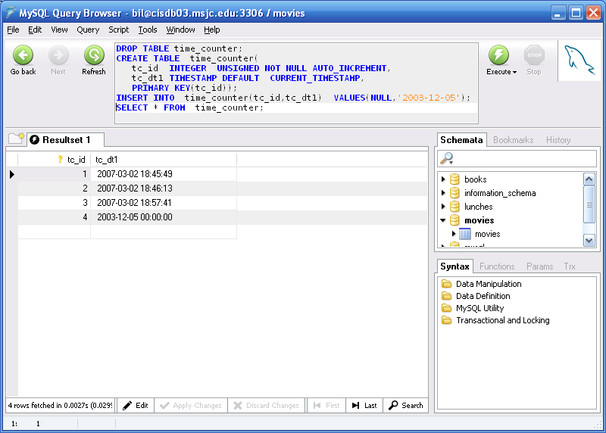
Module 02: Defining Tables Page F-9: Temporal
This default timestamp value can be overridden at the time the record is created, by explicitly providing a datetime value for that column.

Slide 49
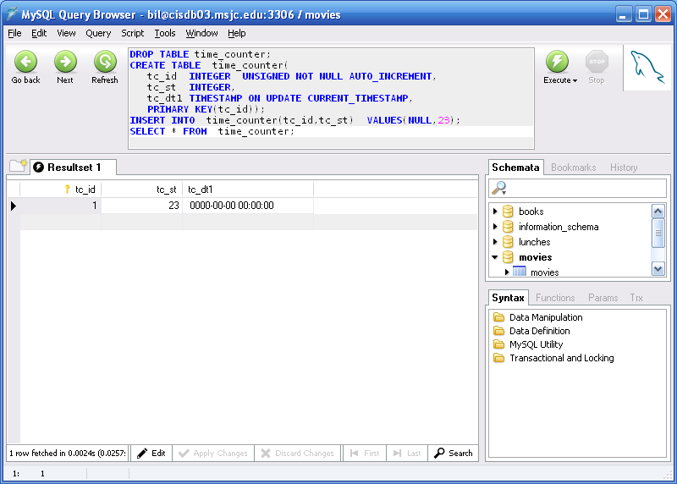
Module 02: Defining Tables Page F-10: Temporal
The ON UPDATE option provides a simple and convenient way for a column to hold a timestamp value to track whenever that record has been changed (updated).
Here’s an example showing a record being created.
Note that the timestamp field is essentially ‘0’.

Slide 50
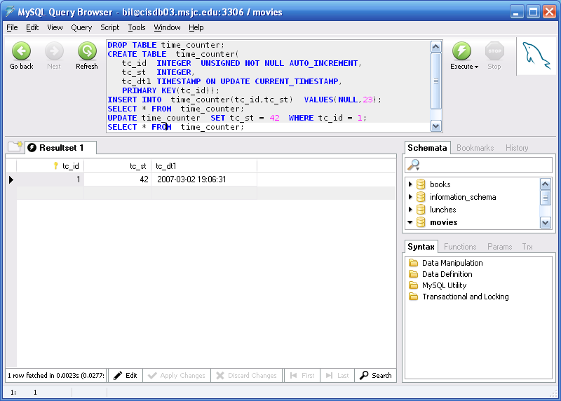
Module 02: Defining Tables Page F-11: Temporal
And whenever that record is updated, the timestamp column automatically records the timestamp for that change.

Slide 51
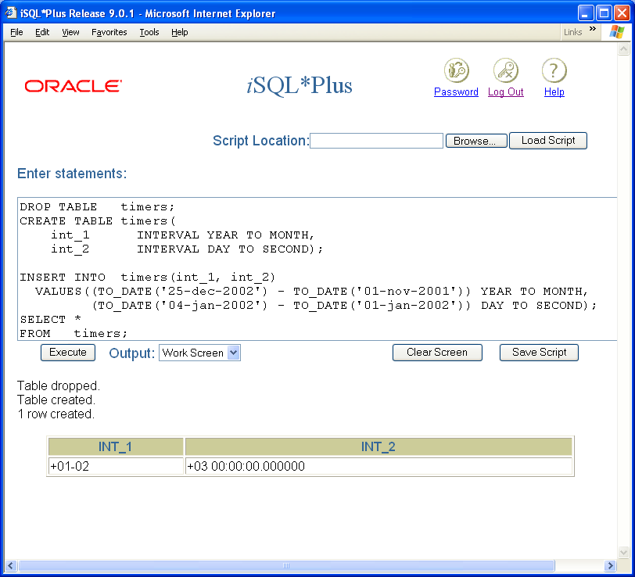
Module 02: Defining Tables Page F-12: Temporal
The INTERVAL data type stores time interval data.
The intervals of time that the standard supports are
years
months
year and months
day to hour
day to minute
day to second
seconds
minute to second

Slide 52
Module 02: Defining Tables Page F-13: Temporal
Oracle (9.2) supports these interval data types:
YEAR TO MONTH
DAY TO SECOND

Slide 53
Module 02: Defining Tables Page F-14: Temporal
MySQL does NOT support an interval datatype, hence interval values cannot be stored in the database.
But MySQL does permit using interval values in datetime operations.

Slide 54
Module 02: Defining Tables Page G-1: Tables CREATE and DROP
As has been demonstrated in many of the examples in this, and prior modules, tables are established in the database with the CREATE command.
The CREATE TABLE command assigns the name of the table, as well as the specifics of that data structure.
To remove a data structure from the database, the programmer uses the DROP statement. The DROP statement is patterned after the CREATE statement, and the syntax requires the programmer to not only identify the structure by name, but also to indicate the type of structure that is being removed.
For example DROP TABLE table_name;

Slide 55
Module 02: Defining Tables Page H-1: Storage Engines
And oh by the way, did I mention that ….
MySQL uses a variety of storage engines to manage the tables in its database. Each of these storage engines has its own peculiar way of doing things, and any table in the MySQL database can be assigned to any one of these storage engines.
Of the half dozen or so different storage engines available, the InnoDB one comes closest to providing the kind of multi-user support that I’ve been describing throughout these SQL courses. And, unless I tell you otherwise, my notes and lectures on MySQL will presume that the InnoDB engine is in use.
Now these other storage engines do have some pretty cool features, but I won’t be mentioning them here again. If you’d like to learn more about them, the MySQL manuals provide a pretty good description of them, and I formally address the topic in the Database Administration course.

Slide 56
Module 02: Defining Tables Page T-1: Terminology
Fixed-length
Variable-length
Binary, BIT, BIT VARYING, BLOB
Boolean
Character
Character set
Glyph
Collation scheme (collating sequence)
Right padding
Exact numerics
Approximate numerics
Timestamp
Time zone
Greenwich meridian time, Greenwich Mean Time, GMT, Universal Coordinated Time, UCT
Intervals
Storage engines

Slide 57
Module 02: Defining Tables Page Z-1: End Notes
Please drop me an email if you noticed any errors in this module. I’d also appreciate reading your comments, criticisms, and or suggestions as to how this module could be improved.
Were there any gaps in the information that was presented (ie. ‘leaps of faith’)?
Was any section unclear?
Did I happen to do a good job? ☺
Thanks,
bil

Slide 58
That’s All

